Slide 1
Beach Bowl Galaxy

Slide 2
Overview
After getting knocked out by the vaccine for 2 days, there were 2 days left to implement flocking into project 2 (slime mold file didn’t work). So, at midnight on Monday success was finally achieved and I wanted to relax, so I gave the resulting galaxy-looking system a beachy color scheme and a 2d displacement like you’re looking at it on a day so hot you can see the heat waves.
The system itself moves particles towards each other if they’re somewhat close, and perpendicular to each other once they get really close. The emergent behavior makes them spiral outwards.

Slide 3
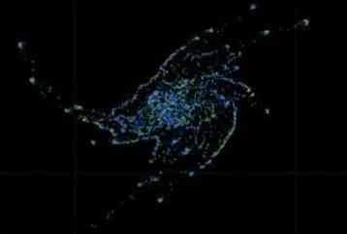

Slide 4
https://github.com/AndrewDunne/CMPM169Projects/tree/main/Proj3
so big it takes 2 lines!

Slide 5
Sources, help, and related research
StackOverflow and Issei for providing wonderful bugfixing help
Super Mario Galaxy for the project name
This video about coding boids, by Sebastian Lague
Project base files by Oskar Elek

